Slide 1
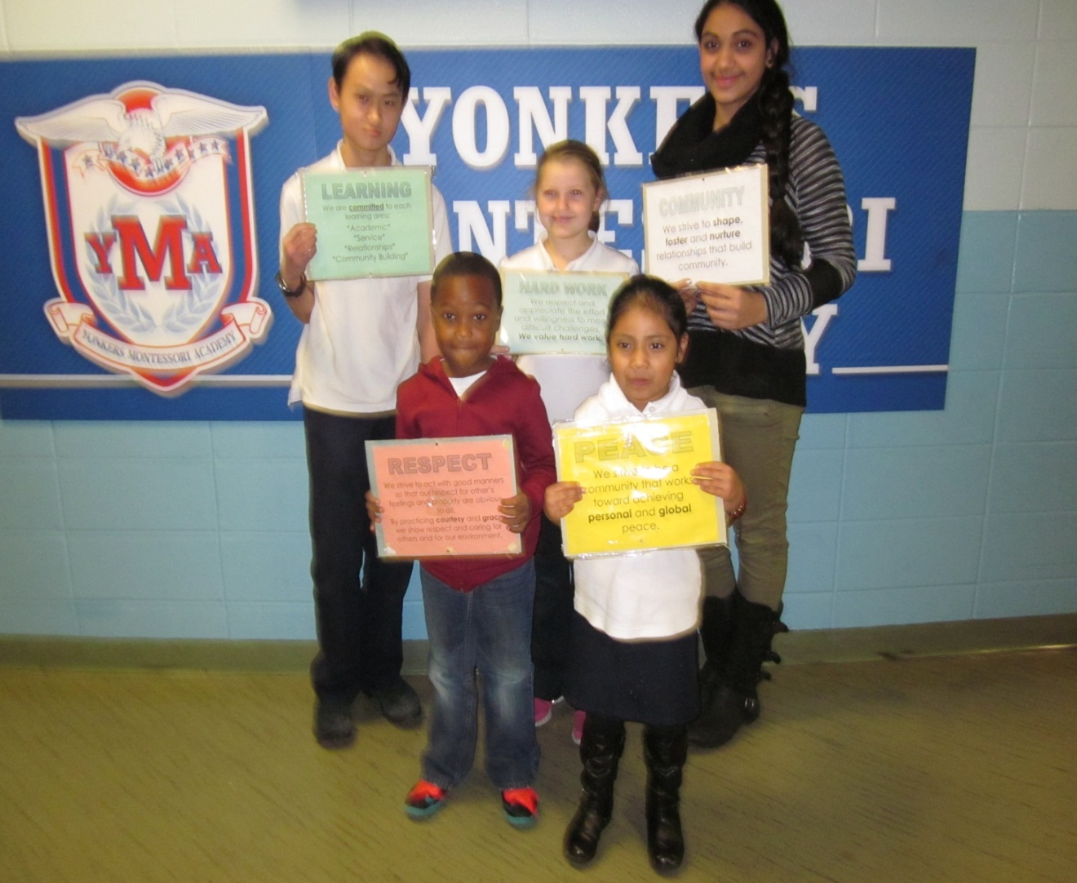
THE GUIDING PRINCIPLES OF A MONTESSORI EDUCATION
LEARNING
HARD WORK
RESPECT
COMMUNITY
PEACE

Slide 2
LEARNING
We are committed to each learning area:
*Academic
*Service
*Relationships
*Community Building

Slide 3
HARD WORK
We respect and appreciate the effort
and willingness to meet difficult challenges.
We value hard work.

Slide 4
RESPECT
We strive to act with good
manners so that our respect for
other’s feelings and property are
obvious to all.
By practicing courtesy and grace, we show respect and caring for others and for our environment

Slide 5
COMMUNITY
We strive to shape, foster and nurture relationships that build community.

Slide 6
PEACE
We strive to be a community that works toward achieving personal and global peace.

